Slide 1


Executive Summary
The Business Challenge | Approach (Data) | Key Questions Addressed.
Situation: WFH rate increases 5 times from 2011 to 2021 (6.4% to 32%) Challenge: Current transport timetable and service schedules no longer align with these demand patterns Goal: Optimize scheduling to meet current and anticipated demand based on data-driven insights. | Analysis of publicly available ABS data across two time periods focusing on Location of Work vs. Residence and Mode of Transport. | Usage Trends: High-level shifts by transport type. WFH Impact: How remote work is reshaping the peak hour and transport planning. New Routes: Evidence-based locations for new CBD-bound bus routes. The CommBank iQ Edge: How banking transactional data can transform these insights from "demographic snapshots" into "real-time behavioral intelligence".

Slide 2
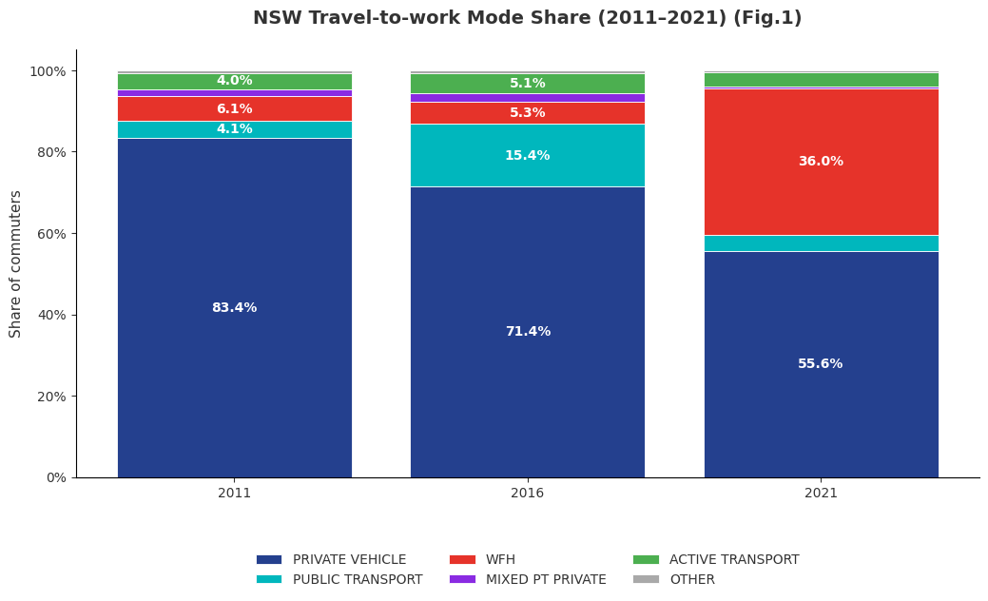
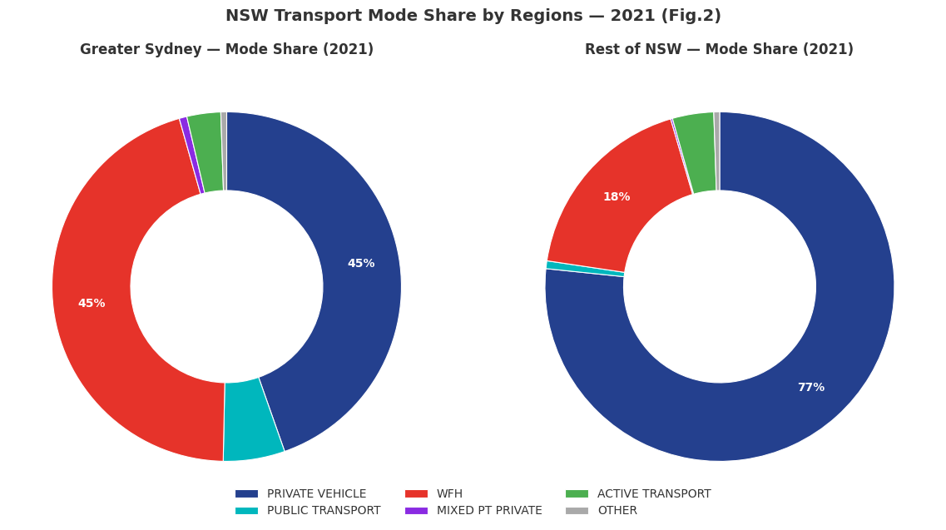
What are the overall usage trends by transport type?
WFH growth has reduced total commuting demand, weakening traditional weekday peak patterns rather than redistributing trips across modes.
Private transport is dominant but declined sharply (-28% from 2011 to 2021) (Fig.1)
WFH increased dramatically, +30% (2016-2021), ~36% of workers (Fig.1)
Among physical commuters (excld WFH), the Private Vehicle is 86.8% in 2021 (from 75.4% in 2016)
In 2021, WFH (39.1%) and Private Vehicle (38.5%) were nearly equal in Greater Sydney while in Regional NSW, WFH was only 15.8%, Private Vehicles accounted for 67% (Fig.2)
Centre: all day services, connecting hubs to CBD, regional: hub to hub express service

Slide 3
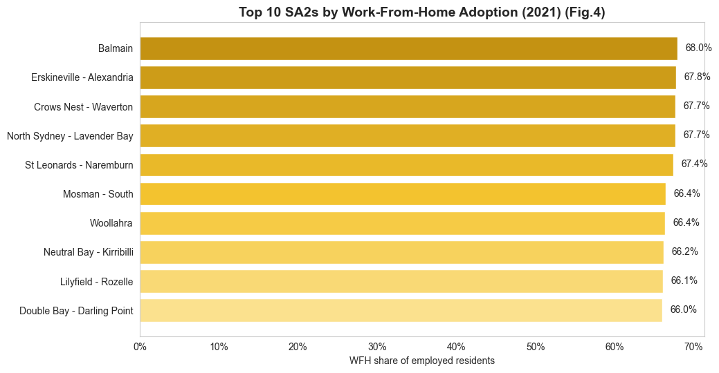
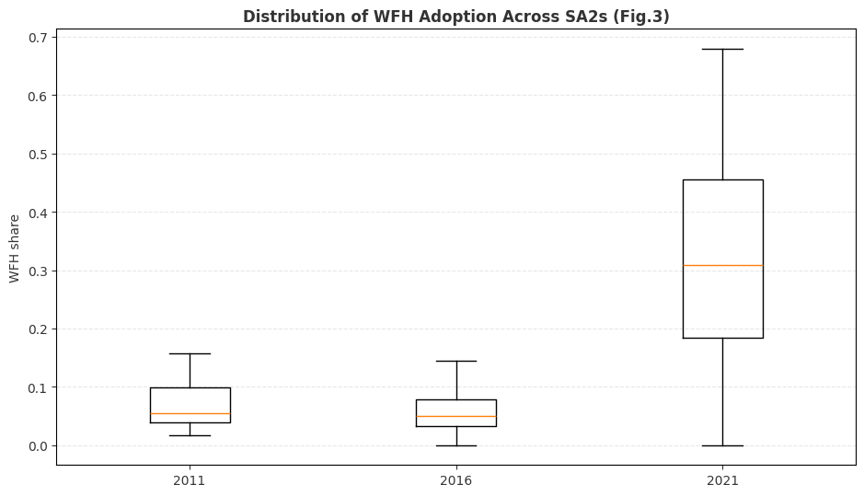
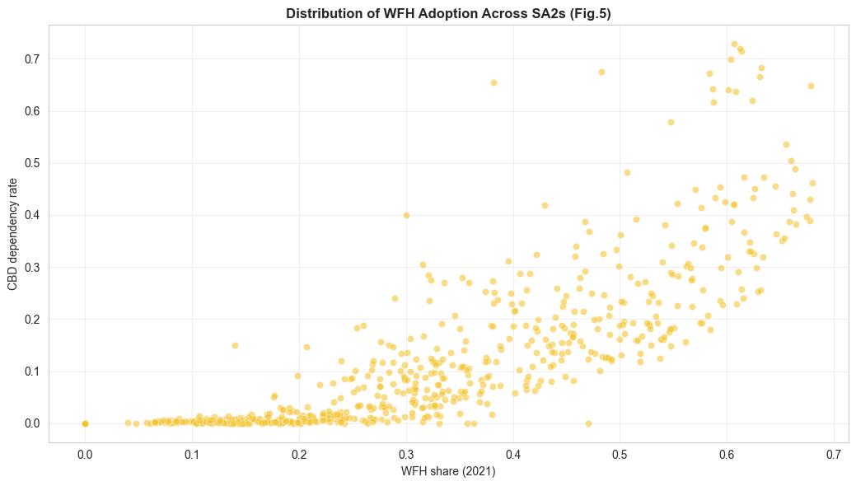
How has WFH changed and what does this mean for planning?
WFH has fragmented weekday demand, reducing frequency but not CBD reliance, requiring more localised and flexible transport planning
Insights
WFH adoption increased sharply and unevenly, with median SA2 WFH rate from ~5% to ~30% (2011-2021), individual SA2s ranging from 0% to ~70% (Fig.3)
In several high-density residential areas, over 2/3 of the workforce now work from home (Balmain, Erskineville – Alexandria) (Fig.4)
Higher WFH adoption is associated with higher CBD dependency, indicating WFH is most prevalent among CBD-based workers (Fig. 5)
Impact on Transport Planning
CBD travel is still important less regular. Planning should shift from "peak capacity" to "consistent frequency" throughout the day.
NSW Transport should adopt place-based and flexible service planning, scaling services at growth areas with lower WFH potential (e.g., outer suburbs where manual/service labor is more prevalent)
At high WFH areas, their travel patterns likely shift toward local trips. Transport planning should prioritize local neighborhood connections

Slide 4
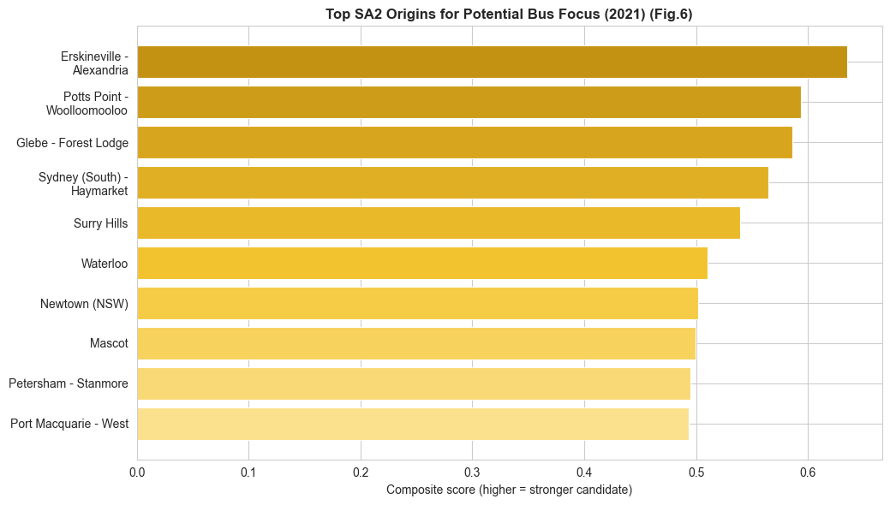
Where should NSW Transport consider prioritising bus services?
Targeted CBD bus routes in these SA2s offer the highest near-term return, serving real, growing demand where public transport is currently under-provided.
Score Distribution:
40% – High absolute CBD commuter volume
20% – Positive CBD commuter growth (2016–21)
20% – Low current public transport share
10% – Lower WFH rate (greater likelihood of physical commuting)
10% – Presence of mixed-mode travel (indicating multimodal openness)
Erskineville–Alexandria, Potts Point–Woolloomooloo, and Glebe–Forest Lodge dominate due to high absolute volumes of CBD-bound commuters (each in the hundreds) combined with low public transport share (≈30–40%) (Fig.6)
Sydney (South)–Haymarket, Surry Hills, and Waterloo rank highly because of very low WFH rates (generally below ~25%) (Fig.6)
Port Macquarie–West is the only regional SA2 in the top 10, driven by extremely low public transport share (below 1%) and limited WFH adoption (around 10–15%) (Fig.6)

Slide 5
How CommBank iQ & other data could strengthen insights?
What CommBank iQ transaction data can add:
Gap in current analysis | What CommBank iQ adds | Use Case
Static census snapshots | Near-real-time trends (monthly/weekly) | Build time-of-day and day-of-week demand profiles
Place of work SA2 only | Actual destination activity for other purposes (retail, education, health) | Identify popular destinations for public transport
No spending behavior | Spending behavior (High toll and parking spend) | Identify areas likely to benefit most from improved public transport
What other datasets can add:
Other datasets | Use Case
Opal Card Tap-on/off Data | Identify which existing routes are overloaded/underused
Road congestion / speed profiles | Choose corridors where buses can actually deliver time advantage.
Land use + growth forecasts | Predictive planning for future growth demand
Major Events & Stadium Calendars | Model temporary demand spikes

Slide 6
Recommendations and Limitations
Recommendations:
Phase 1: Validation & Precision (Immediate) | Phase 2: Targeted Pilot Programs (Short-Term) | Phase 3: Strategic Network Evolution (Medium-Term)
Mode Substitution Analysis: Use toll and fuel transaction data to validate "willingness to switch" | High-Potential Express Trials: Launch 3-month express bus pilots with some incentives for high-growth corridors to capture car-commuter volumes. | Holistic Data Integration: Merge Opal tap-on data with CBAiQ merchant spending to identify "Network Leakage”, where people are active but public transport is not their chosen mode.
Temporal Demand Mapping: Use CBA transaction timestamps to identify the exact hours of the "new peak" in high-WFH for optimized scheduling. | Micro-Mobility Feeders: Trial local shuttles in "Professional Hubs" | Predictive Infrastructure: Use building approvals and CBAiQ residential growth data to pre-emptively design routes for emerging South West development corridors.
Persona Segmentation: Apply de-identified spending patterns to differentiate service needs between "Hybrid Professionals" and "Essential Service Workers."
Limitations
Data Constraints | Human & Behavioural Constraints | Time & Operational Constraints
Static Snapshot: does not capture seasonal variations | Inertia and Habit: Even if a new bus route is data-justified, human behavior is slow to change | Infrastructure Lead Times: the procurement of new buses, driver recruitment, and physical stop installations can take months or years, during which time commuter patterns may have shifted again

